Slide 1
Triggers & Refactoring
Rob Vatz
Email : rob.vatz@sceneralabs.com
Notes:
Setup: 1. Bring up document folder, 2. SSMS connected with scripts 2,3,4,5, 3. USE Demo1, 4. Have PowerPoint up, have slides share mode
I’m Rob Vatz of Scenera Research. This mini-talk is about triggers in the context of refactoring a database.
I’ve run into a situation at work where I needed to change tables in a production database that has a lot of code referring to it. S

Slide 2
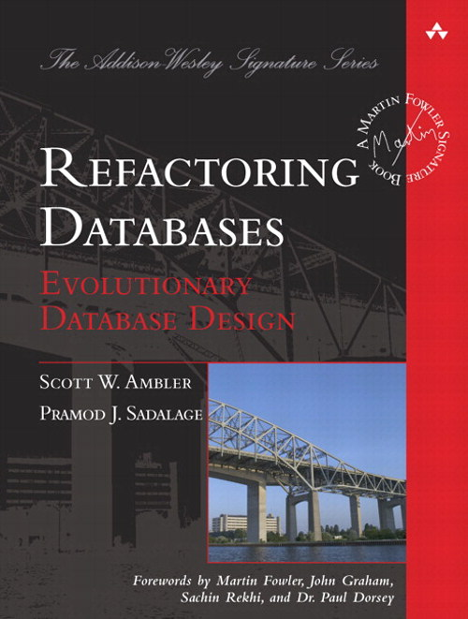
Refactoring Databases Book
Notes:
So I looked at this book, Refactoring Databases. I learned from reading it that I was going to have to learn about triggers, You need triggers to keep the old version and the new version of the data in sync. I hadn’t used triggers before, so I created a test database to learn the concepts.

Slide 3
Demo
Notes:
Run Setup, show OLD table, Show goals of refactor,
Trigger featueres
(Will talk about code at top of trigger later.)
UPDATE(column), inserted pseudo-table, deleted pseudo-table
"WHERE Customer.CustomerId = inserted.CustomerId" clause to keep from changing every row.
LEFT OUTER JOIN needed, so ISNULL(deleted.column,...) needed in WHERE clauses.
Both needed to handle INSERT situation.

Slide 4
Lessons Learned
SET RECURSIVE_TRIGGERS OFF/ON
Triggers execute even if table contents doesn’t change
Testing is painful, especially setup, so…
Have a test script
Use version control
Notes:
Discovered the RECURSIVE_TRIGGER option. By default, It’s off. Learned what happens when it’s on, namely…
Triggers execute even if no rows are changed.
Setting up a test is a lot of work, so have a test script.
Automated unit tests is a good idea: you back up and start all over a lot. You need to cover all cases: INSERT/UPDATE; old/new.
Because of lesson #1, version control is probably a good idea
Changelog table was a good debugging tool
=======
Need "WHERE Customer.CustomerId = inserted.CustomerId" clause to keep from changing every row. Tests probably need to verify all rows.
LEFT OUTER JOIN needed, so ISNULL(deleted.column,...) needed in WHERE clauses.
Both needed to handle INSERT situation.

Slide 5
References
Evolutionary Database Design: http://martinfowler.com/articles/evodb.html
Expand/Contract pattern: http://martinfowler.com/bliki/ParallelChange.html
Refactoring Databases book

Slide 6
Questions?

